Slide 1
Session 1:
To be Familiar
A capella, instrumental, spoken, whole
Unfamiliar
4 types
Session 2:
Familiar
4 types
Unfamiliar
4 types

Slide 2
As participants become more familiar with the stimuli, the amount of dissimilarity between the stimuli should increase
i.e. it should be easier to tell familiar stimuli apart

Slide 3
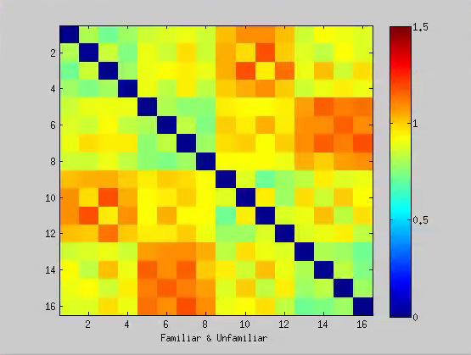
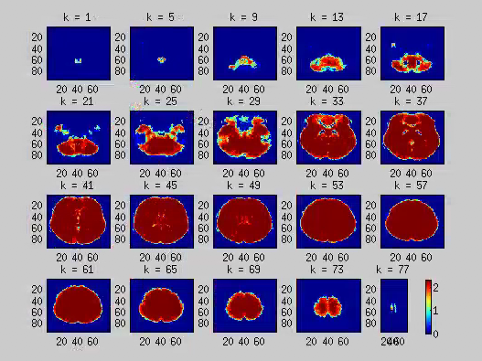
Familiar & Unfamiliar
Ses1 & Ses2
GW mask
fam
Session 1
unfam
fam
Session 2
unfam
fam
unfam
fam
unfam
Session 1
Session 2
Most dissimilar across sessions
Fam-unfam comparisons are more dissimilar than fam-fam or unfam-unfam
Whole brain is significant because individual searchlights return whole brain…
Notes:
Ses1fam ses1unfam ses2fam ses2unfam
1234
----- Meeting Notes (19-03-01 14:27) -----
conjunction - areas active during both conditions.
Check GLM

Slide 4
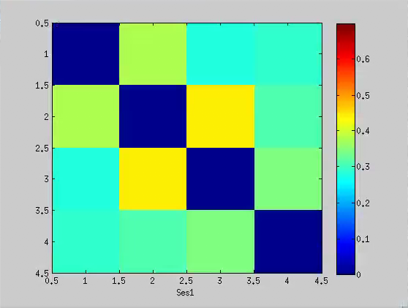
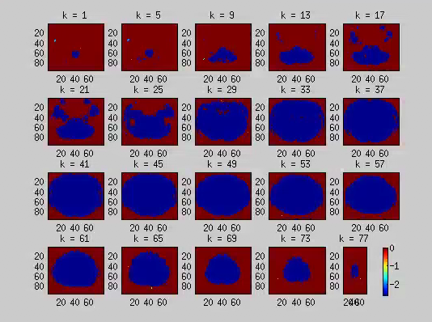
A
Session 1
I
S
W
A capella
spoken
whole
instrumental
spoken– instrumental: most dissimilar
Acapella-instrumental: next most dissim.
??
Notes:
1234 (aisw)

Slide 5
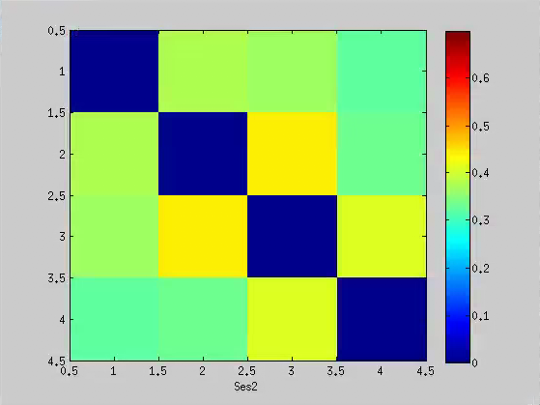
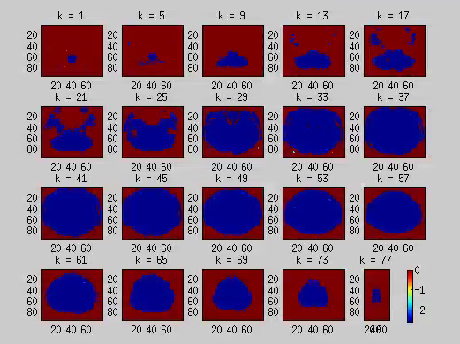
Session 2
A
Compared to session 1, things are more dissimilar in session 2
I
S
W
A capella
spoken
whole
instrumental
Instrumental-spoken: most
Spoken-whole
acapella-instrumental
Acapella-spoken
??
Notes:
1234

Slide 6
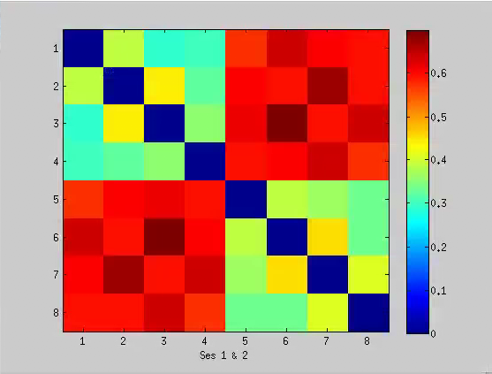
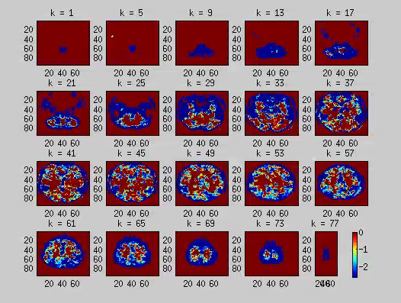
Session 1 and 2
Session 1
Session 2
Session 1
Session 2
Session 1 and session 2 are very dissimilar
Most dissimilar across sessions:
Instrumental(2/6)-spoken(3/7)
??
Notes:
Ses1 ses2
1234 1234 (aisw)

Slide 7
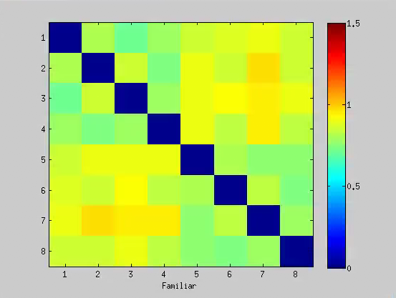
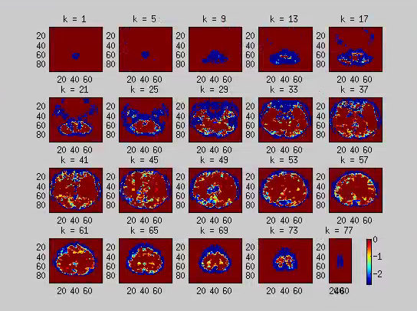
Familiar songs only
Session 1
Session 2
Session 1
Session 2
More similarities within session than across
But no difference between session 1 and 2
??
Notes:
Ses1fam ses2fam
1234

Slide 8
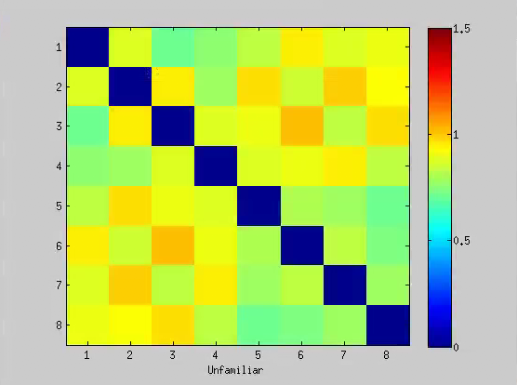
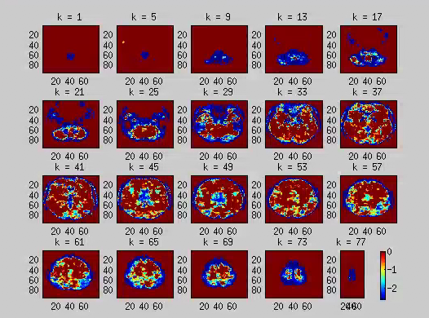
Unfamiliar songs only
Session 1
Session 2
Session 1
Session 2
More similarities within session than across
But no difference between session 1 and 2
??
Notes:
Ses1unfam ses2unfam
1234

